Slide 1
Design Of FIR Filter Design
Module :5 Week 10

Slide 2
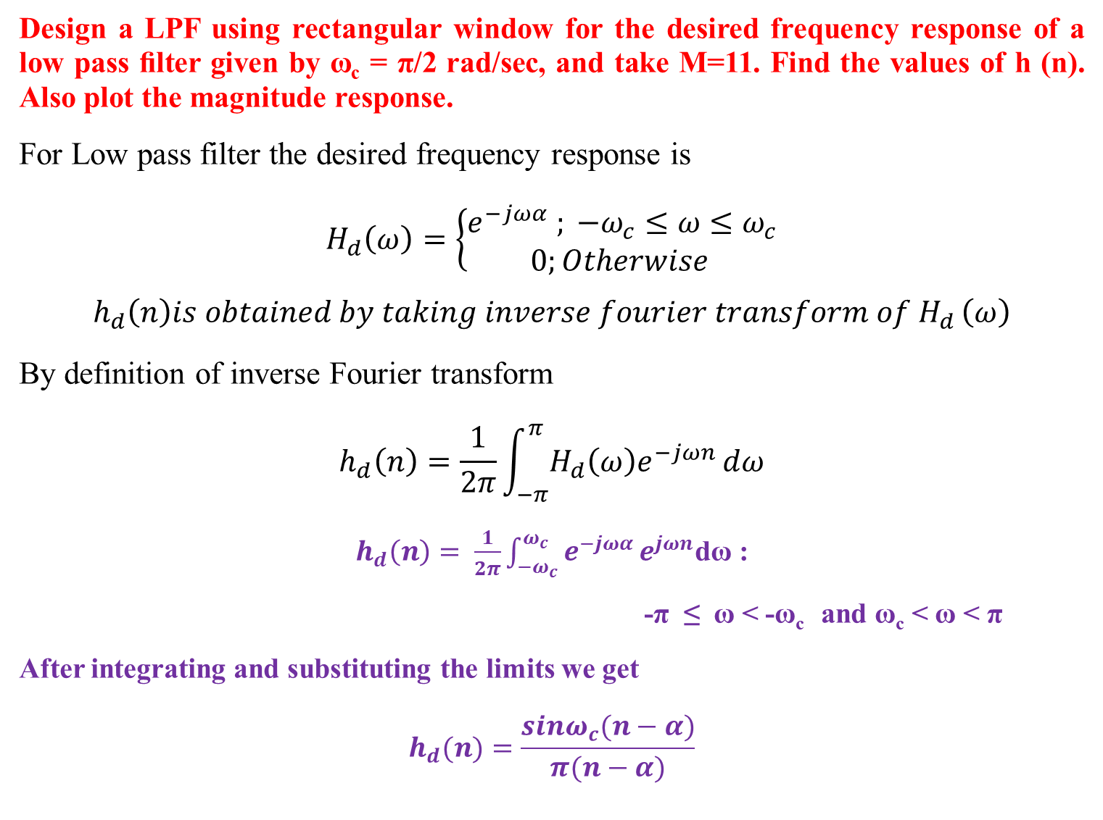
Design a LPF using rectangular window for the desired frequency response of a low pass ﬁlter given by ω_{c} = π/2 rad/sec, and take M=11. Find the values of h (n). Also plot the magnitude response.
For Low pass filter the desired frequency response is
$H_{d}\left(ω\right)=\left\{\begin{aligned}e^{−jωα} ; −ω_{c}≤ω≤ω_{c} \\ 0;Otherwise \end{aligned}\right.$
$$h_{d}\left(n\right)is obtained by taking inverse fourier transform of H_{d }\left(ω\right)$$
By definition of inverse Fourier transform
$$h_{d}\left(n\right)=\frac{1}{2π}\int_{−π}^{π}{H_{d}\left(ω\right)e^{−jωn}dω}$$
$h_{d}\left(n\right)= \frac{1}{2π}\int_{−ω_{c}}^{ω_{c}}{e^{−jωα}}e^{jωn}$dω :
-π ≤ ω < -ω_{c} and ω_{c} < ω < π
After integrating and substituting the limits we get
$$h_{d}(n)=\frac{sinω_{c}(n−α)}{π(n−α)}$$

Slide 3
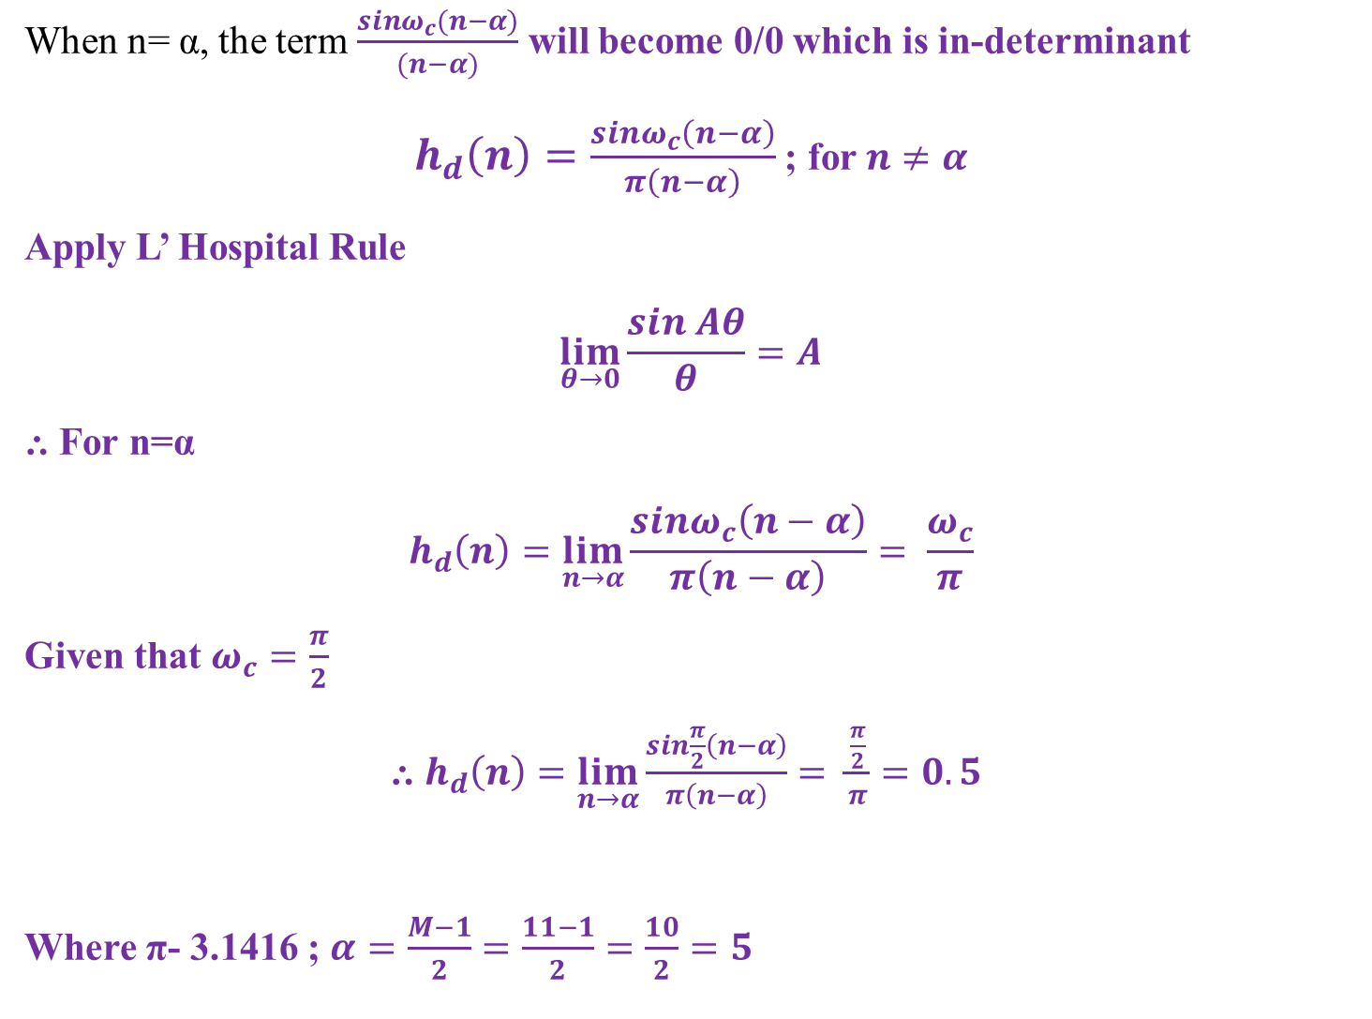
When n= α, the term $\frac{sinω_{c}(n−α)}{(n−α)}$ will become 0/0 which is in-determinant
$h_{d}\left(n\right)=\frac{sinω_{c}\left(n−α\right)}{π\left(n−α\right)}$ ; for $n≠α$
Apply L’ Hospital Rule
$$\lim_{θ→0}{\frac{sin Aθ}{θ}=A}$$
⸫ For n=α
$$h_{d}\left(n\right)=\lim_{n→α}{\frac{sinω_{c}\left(n−α\right)}{π\left(n−α\right)}}= \frac{ω_{c}}{π}$$
Given that $ω_{c}=\frac{π}{2}$
⸫ $h_{d}\left(n\right)=\lim_{n→α}{\frac{sin\frac{π}{2}\left(n−α\right)}{π\left(n−α\right)}}= \frac{\frac{π}{2}}{π}=0.5$
Where π- 3.1416 ; $α=\frac{M−1}{2}=\frac{11−1}{2}=\frac{10}{2}=5$

Slide 4
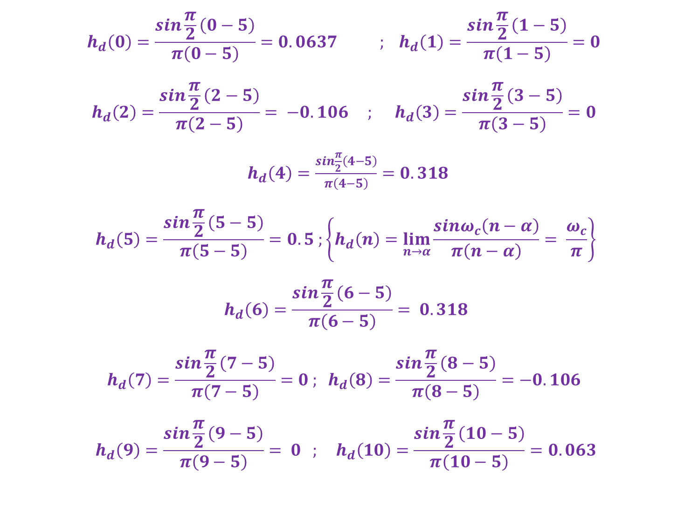
$$h_{d}\left(0\right)=\frac{sin\frac{π}{2}\left(0−5\right)}{π\left(0−5\right)}=0.0637{ ; h}_{d}\left(1\right)=\frac{sin\frac{π}{2}\left(1−5\right)}{π\left(1−5\right)}=0$$
$$h_{d}\left(2\right)=\frac{sin\frac{π}{2}\left(2−5\right)}{π\left(2−5\right)}= −0.106 ; h_{d}\left(3\right)=\frac{sin\frac{π}{2}\left(3−5\right)}{π\left(3−5\right)}=0$$
$h_{d}\left(4\right)=\frac{sin\frac{π}{2}\left(4−5\right)}{π\left(4−5\right)}=0.318$
$$h_{d}\left(5\right)=\frac{sin\frac{π}{2}\left(5−5\right)}{π\left(5−5\right)}=0.5 ;\left\{h_{d}\left(n\right)=\lim_{n→α}{\frac{sinω_{c}\left(n−α\right)}{π\left(n−α\right)}}= \frac{ω_{c}}{π}\right\}$$
$$h_{d}\left(6\right)=\frac{sin\frac{π}{2}\left(6−5\right)}{π\left(6−5\right)}= 0.318$$
$$h_{d}\left(7\right)=\frac{sin\frac{π}{2}\left(7−5\right)}{π\left(7−5\right)}=0 ; h_{d}\left(8\right)=\frac{sin\frac{π}{2}\left(8−5\right)}{π\left(8−5\right)}=−0.106$$
$$h_{d}\left(9\right)=\frac{sin\frac{π}{2}\left(9−5\right)}{π\left(9−5\right)}= 0 ; h_{d}\left(10\right)=\frac{sin\frac{π}{2}\left(10−5\right)}{π\left(10−5\right)}=0.063$$

Slide 5
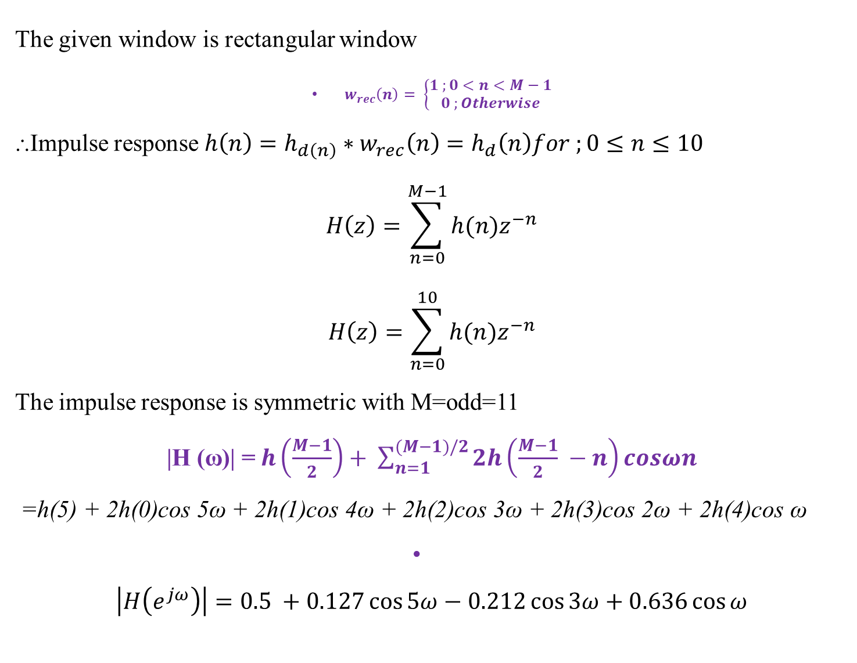
The given window is rectangular window
$w_{rec}\left(n\right)= \left\{\begin{aligned}1 ;0<n<M−1 \\ 0 ;Otherwise\end{aligned}\right.$
⸫Impulse response $h\left(n\right)=h_{d\left(n\right)}∗w_{rec}\left(n\right)=h_{d}\left(n\right)for ;0≤n≤10$
$$H\left(z\right)=\sum_{n=0}^{M−1}{h(n)z^{−n}}$$
$$H\left(z\right)=\sum_{n=0}^{10}{h(n)z^{−n}}$$
The impulse response is symmetric with M=odd=11
|H (ω)| =$h\left(\frac{M−1}{2}\right)+ \sum_{n=1}^{(M−1)/2}{2h\left(\frac{M−1}{2} −n\right)cosωn}$
=h(5) + 2h(0)cos 5ω + 2h(1)cos 4ω + 2h(2)cos 3ω + 2h(3)cos 2ω + 2h(4)cos ω
$$\left|H\left(e^{jω}\right)\right|=0.5 +0.127\cos{5ω}−0.212\cos{3ω}+0.636\cos{ω}$$

Slide 6
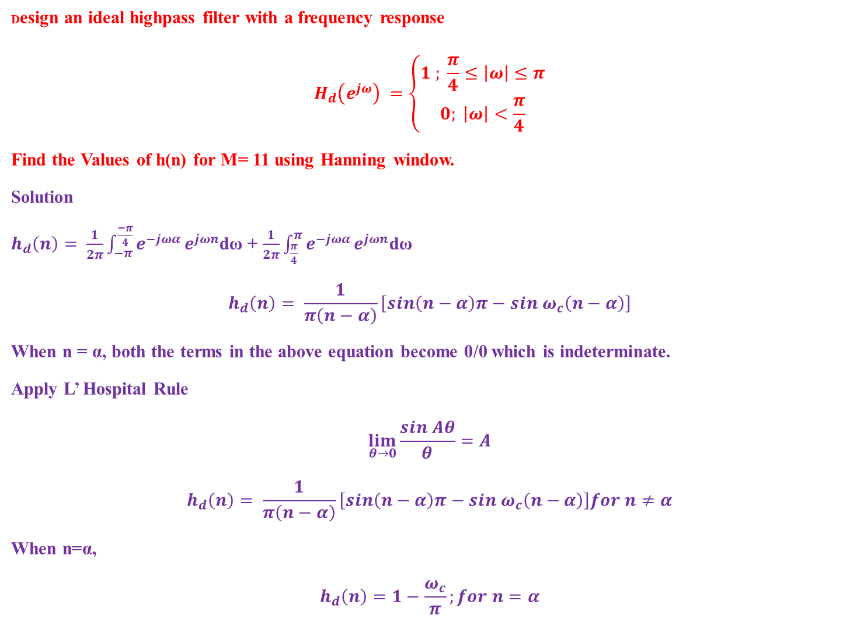
Design an ideal highpass filter with a frequency response
$$H_{d}\left(e^{jω}\right) =\left\{\begin{aligned}1 ; \frac{π}{4}≤\left|ω\right|≤π \\ 0; \left|ω\right|<\frac{π}{4}\end{aligned}\right.$$
Find the Values of h(n) for M= 11 using Hanning window.
Solution
$h_{d}\left(n\right)= \frac{1}{2π}\int_{−π}^{\frac{−π}{4}}{e^{−jωα}}e^{jωn}$dω + $\frac{1}{2π}\int_{\frac{π}{4}}^{π}{e^{−jωα}}e^{jωn}$dω
$$h_{d}\left(n\right)= \frac{1}{π\left(n−α\right)}\left[sin\left(n−α\right)π−sin ω_{c}\left(n−α\right)\right]$$
When n = α, both the terms in the above equation become 0/0 which is indeterminate.
Apply L’ Hospital Rule
$$\lim_{θ→0}{\frac{sin Aθ}{θ}=A}$$
$$h_{d}\left(n\right)= \frac{1}{π\left(n−α\right)}\left[sin\left(n−α\right)π−sin ω_{c}\left(n−α\right)\right]for n≠α$$
When n=α,
$$h_{d}\left(n\right)=1−\frac{ω_{c}}{π};for n=α$$

Slide 7
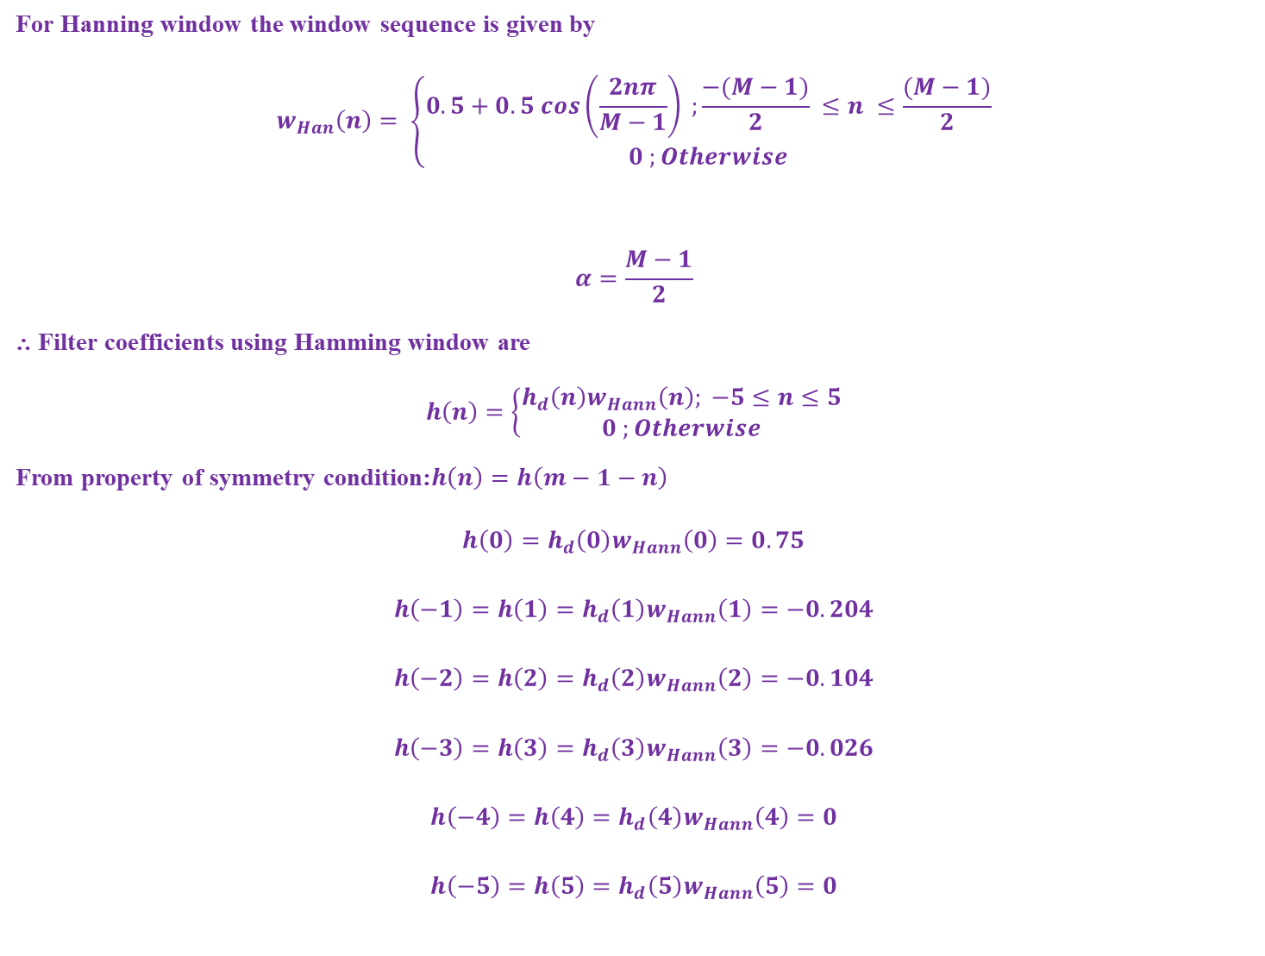
For Hanning window the window sequence is given by
$$w_{Han}\left(n\right)= \left\{\begin{aligned}0.5+0.5 cos\left(\frac{2nπ}{M−1}\right) ;\frac{−(M−1)}{2} ≤n ≤\frac{(M−1)}{2} \\ 0 ;Otherwise\end{aligned}\right.$$
$$α=\frac{M−1}{2}$$
⸫ Filter coefficients using Hamming window are
$$h\left(n\right)=\left\{\begin{aligned}h_{d}\left(n\right)w_{Hann}\left(n\right); −5≤n≤5 \\ 0 ;Otherwise\end{aligned}\right.$$
From property of symmetry condition:$h\left(n\right)=h\left(m−1−n\right)$
$$h\left(0\right)=h_{d}\left(0\right)w_{Hann}\left(0\right)=0.75$$
$$h\left(−1\right)=h\left(1\right)=h_{d}\left(1\right)w_{Hann}\left(1\right)=−0.204$$
$$h\left(−2\right)=h\left(2\right)=h_{d}\left(2\right)w_{Hann}\left(2\right)=−0.104$$
$$h\left(−3\right)=h\left(3\right)=h_{d}\left(3\right)w_{Hann}\left(3\right)=−0.026$$
$$h\left(−4\right)=h\left(4\right)=h_{d}\left(4\right)w_{Hann}\left(4\right)=0$$
$$h\left(−5\right)=h\left(5\right)=h_{d}\left(5\right)w_{Hann}\left(5\right)=0$$

Slide 8
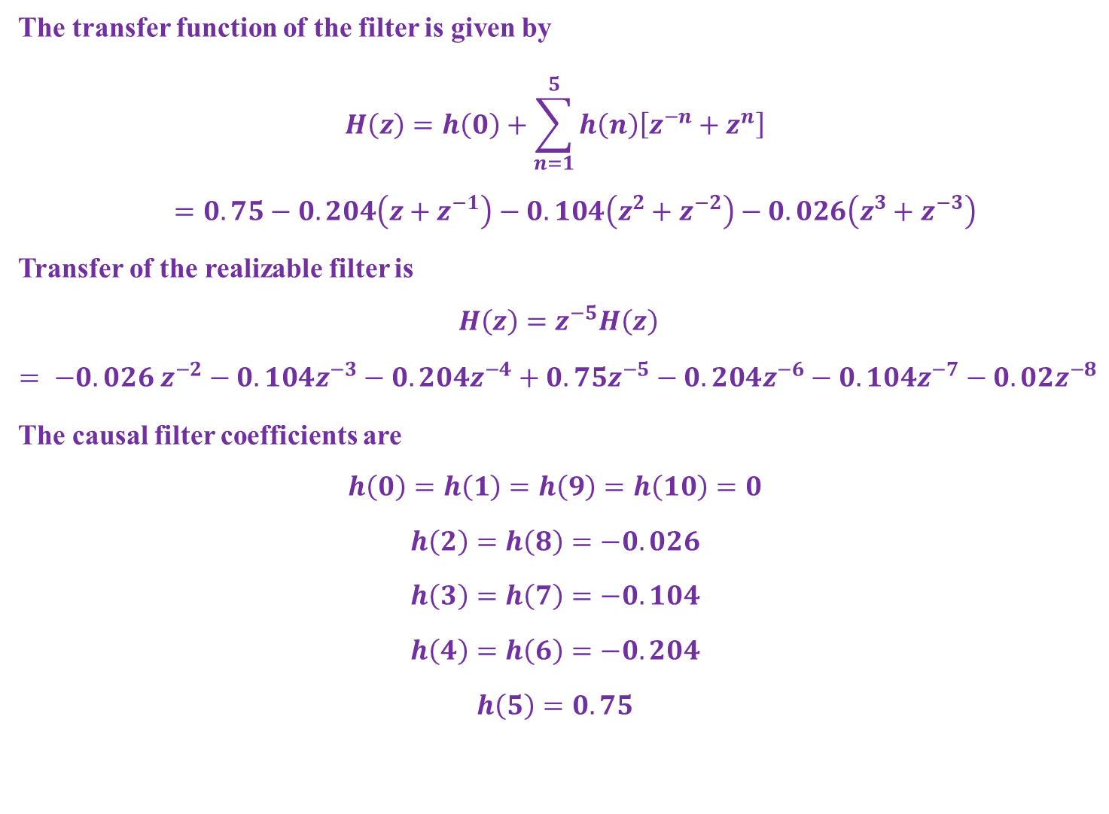
The transfer function of the filter is given by
$$H\left(z\right)=h\left(0\right)+\sum_{n=1}^{5}{h\left(n\right)\left[z^{−n}+z^{n}\right] }$$
$=0.75−0.204\left(z+z^{−1}\right)−0.104\left(z^{2}+z^{−2}\right)−0.026\left(z^{3}+z^{−3}\right)$
Transfer of the realizable filter is
$$H\left(z\right)=z^{−5}H\left(z\right)$$
$$= −0.026 z^{−2}−0.104z^{−3}−0.204z^{−4}+0.75z^{−5}−0.204z^{−6}−0.104z^{−7}−0.02z^{−8}$$
The causal filter coefficients are
$$h\left(0\right)=h\left(1\right)=h\left(9\right)=h\left(10\right)=0$$
$$h\left(2\right)=h\left(8\right)=−0.026$$
$$h\left(3\right)=h\left(7\right)=−0.104$$
$$h\left(4\right)=h\left(6\right)=−0.204$$
$$h\left(5\right)=0.75$$

Slide 9
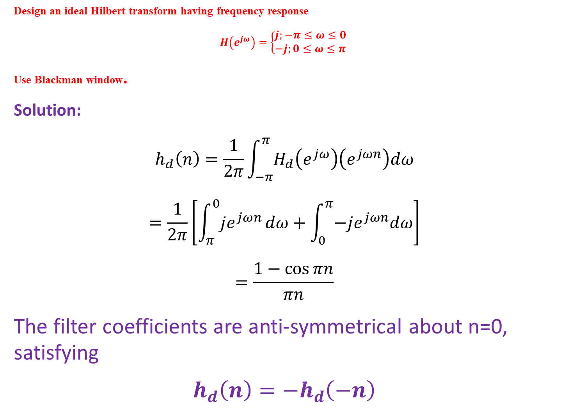
Design an ideal Hilbert transform having frequency response
$$H\left(e^{jω}\right)=\left\{\begin{aligned}j;−π≤ω≤0 \\ −j;0≤ω≤π\end{aligned}\right.$$
Use Blackman window.
Solution:
$$h_{d}\left(n\right)=\frac{1}{2π}\int_{−π}^{π}{H_{d}\left(e^{jω}\right)\left(e^{jωn}\right)dω}$$
$$=\frac{1}{2π}\left[\int_{π}^{0}{je^{jωn}}dω+\int_{0}^{π}{−je^{jωn}dω}\right]$$
$$=\frac{1−\cos{πn}}{πn}$$
The filter coefficients are anti-symmetrical about n=0, satisfying
$$h_{d}\left(n\right)=−h_{d}\left(−n\right)$$

Slide 10
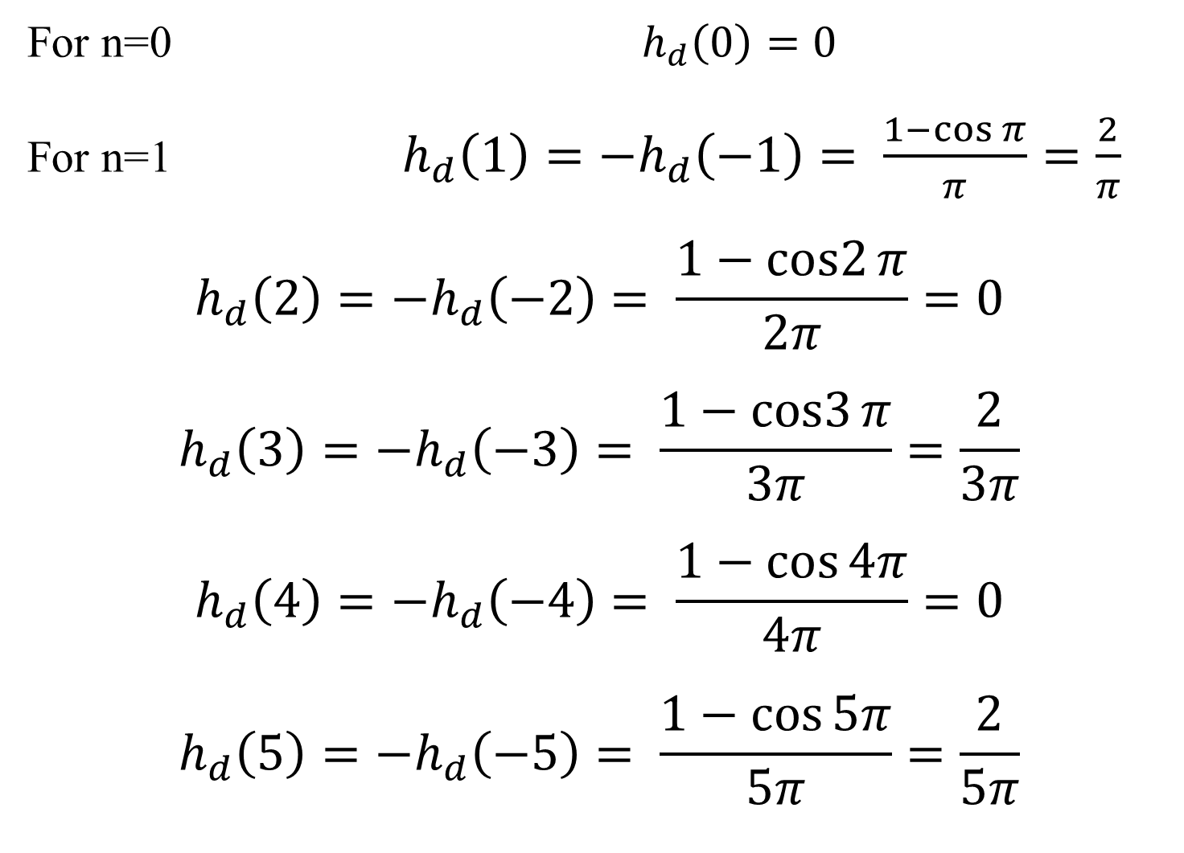
For n=0 $h_{d}\left(0\right)=0$
For n=1 $h_{d}\left(1\right)=−h_{d}\left(−1\right)= \frac{1−\cos{π}}{π}=\frac{2}{π}$
$$h_{d}\left(2\right)=−h_{d}\left(−2\right)= \frac{1−cos2{π}}{2π}=0$$
$$h_{d}\left(3\right)=−h_{d}\left(−3\right)= \frac{1−cos3{π}}{3π}=\frac{2}{3π}$$
$$h_{d}\left(4\right)=−h_{d}\left(−4\right)= \frac{1−\cos{4π}}{4π}=0$$
$$h_{d}\left(5\right)=−h_{d}\left(−5\right)= \frac{1−\cos{5π}}{5π}=\frac{2}{5π}$$

Slide 11
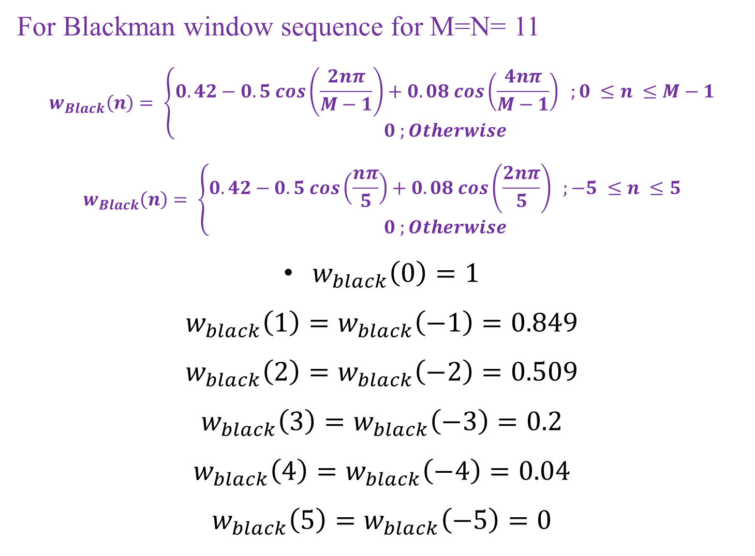
For Blackman window sequence for M=N= 11
$$w_{Black}\left(n\right)= \left\{\begin{aligned}0.42−0.5 cos\left(\frac{2nπ}{M−1}\right)+0.08 cos\left(\frac{4nπ}{M−1}\right) ;0 ≤n ≤M−1 \\ 0 ;Otherwise\end{aligned}\right.$$
$$w_{Black}\left(n\right)= \left\{\begin{aligned}0.42−0.5 cos\left(\frac{nπ}{5}\right)+0.08 cos\left(\frac{2nπ}{5}\right) ;−5 ≤n ≤5 \\ 0 ;Otherwise\end{aligned}\right.$$
$w_{black}\left(0\right)=1$
$$w_{black}\left(1\right)=w_{black}\left(−1\right)=0.849$$
$$w_{black}\left(2\right)=w_{black}\left(−2\right)=0.509$$
$$w_{black}\left(3\right)=w_{black}\left(−3\right)=0.2$$
$$w_{black}\left(4\right)=w_{black}\left(−4\right)=0.04$$
$$w_{black}\left(5\right)=w_{black}\left(−5\right)=0$$

Slide 12
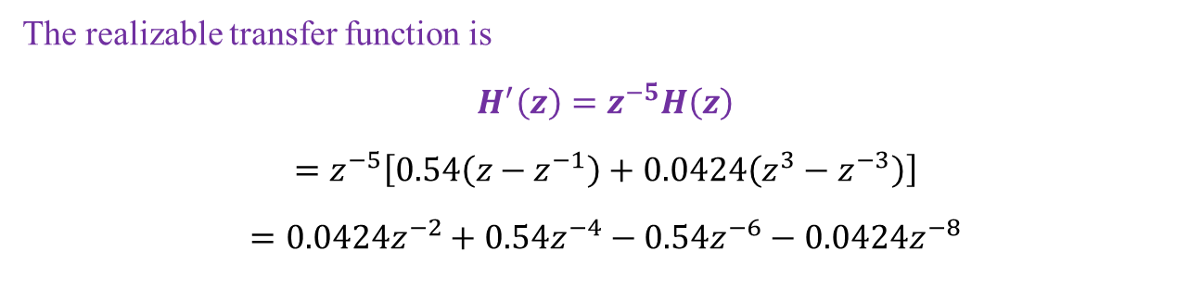
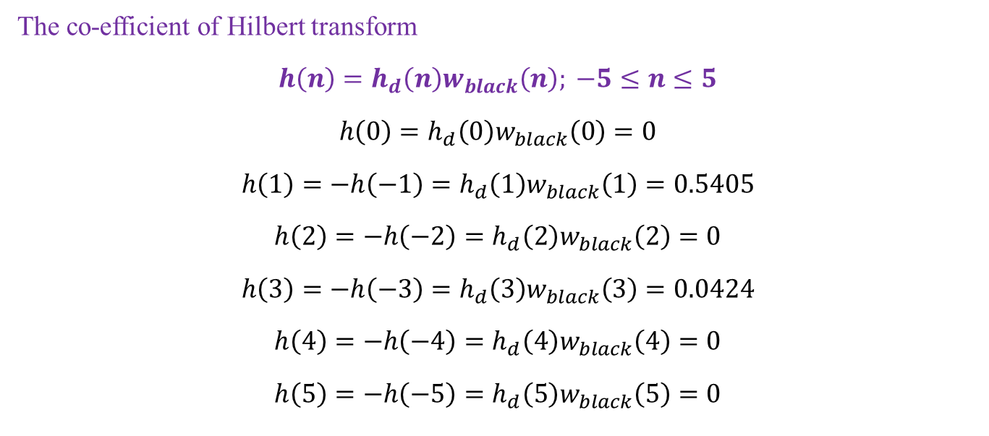
The co-efficient of Hilbert transform
$$h\left(n\right)=h_{d}\left(n\right)w_{black}\left(n\right); −5≤n≤5$$
$$h\left(0\right)=h_{d}\left(0\right)w_{black}\left(0\right)=0$$
$$h\left(1\right)=−h\left(−1\right)=h_{d}\left(1\right)w_{black}\left(1\right)=0.5405$$
$$h\left(2\right)=−h\left(−2\right)=h_{d}\left(2\right)w_{black}\left(2\right)=0$$
$$h\left(3\right)=−h\left(−3\right)=h_{d}\left(3\right)w_{black}\left(3\right)=0.0424$$
$$h\left(4\right)=−h\left(−4\right)=h_{d}\left(4\right)w_{black}\left(4\right)=0$$
$$h\left(5\right)=−h\left(−5\right)=h_{d}\left(5\right)w_{black}\left(5\right)=0$$
The realizable transfer function is
$$H^{′}\left(z\right)=z^{−5}H\left(z\right)$$
$$=z^{−5}\left[0.54\left(z−z^{−1}\right)+0.0424\left(z^{3}−z^{−3}\right)\right]$$
$$=0.0424z^{−2}+0.54z^{−4}−0.54z^{−6}−0.0424z^{−8}$$

Slide 13
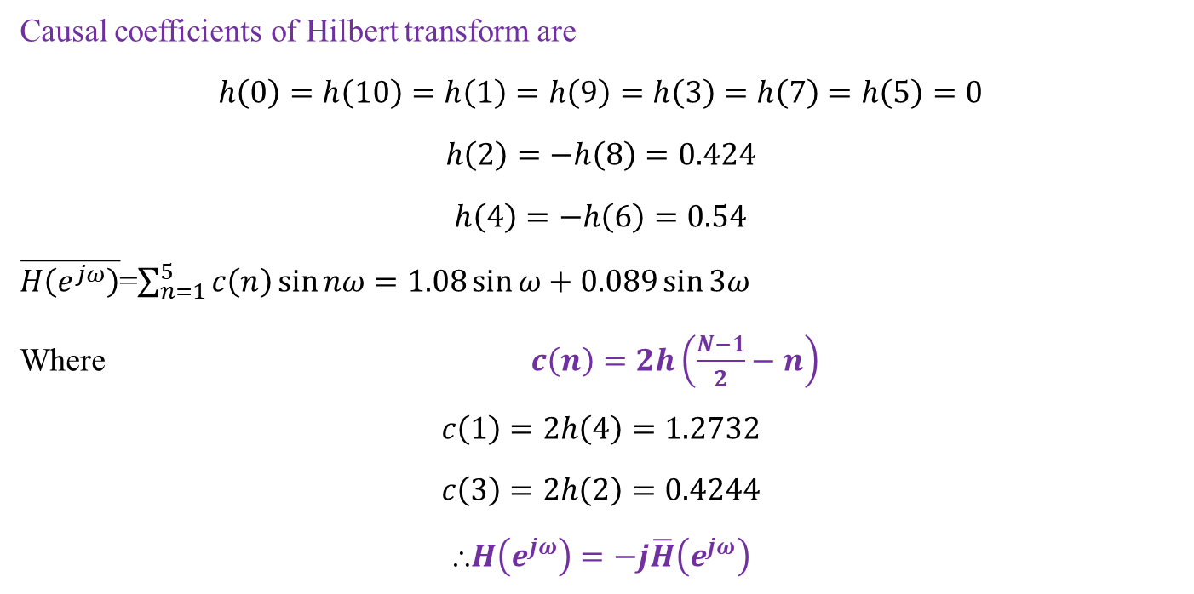
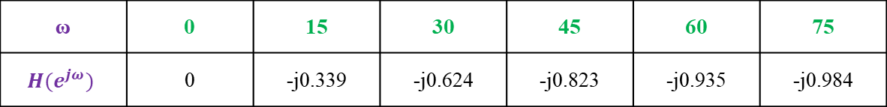
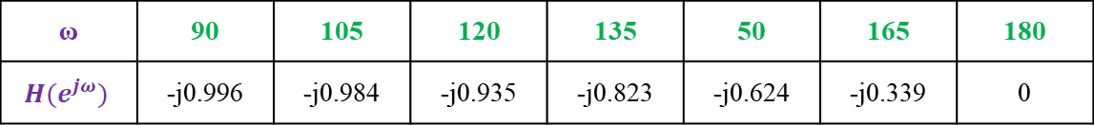
Causal coefficients of Hilbert transform are
$$h\left(0\right)=h\left(10\right)=h\left(1\right)=h\left(9\right)=h\left(3\right)=h\left(7\right)=h\left(5\right)=0$$
$$h\left(2\right)=−h\left(8\right)=0.424$$
$$h\left(4\right)=−h\left(6\right)=0.54$$
$\overline{H\left(e^{jω}\right)}$=$\sum_{n=1}^{5}{c\left(n\right)\sin{nω}}=1.08\sin{ω+0.089\sin{3ω}}$
Where $c\left(n\right)=2h\left(\frac{N−1}{2}−n\right)$
$$c\left(1\right)=2h\left(4\right)=1.2732$$
$$c\left(3\right)=2h\left(2\right)=0.4244$$
⸫$H\left(e^{jω}\right)=−j\overline{H}\left(e^{jω}\right)$
ω | 0 | 15 | 30 | 45 | 60 | 75
$$H(e^{jω})$$ | 0 | -j0.339 | -j0.624 | -j0.823 | -j0.935 | -j0.984
ω | 90 | 105 | 120 | 135 | 50 | 165 | 180
$$H(e^{jω})$$ | -j0.996 | -j0.984 | -j0.935 | -j0.823 | -j0.624 | -j0.339 | 0

Slide 14
Comparison between FIR and IIR Filters
FIR Filter | IIR Filter
The impulse response of this filter is restricted to finite number of samples. | The impulse response of this filter extends over an infinite duration.
FIR filters can have precisely linear phase. | These filters do not have linear phase.
Closed form design equations do not exist. | A variety of frequency selective filters can be designed using closed form design formulas.
Most of the design methods are iterative procedures, requiring powerful computational facilities for their implementation. | These filters can be designed using only a hand calculator and tables of analog filter design parameters.
Greater flexibility to control the shape of their magnitude response. | Less flexibility specially for obtaining non-standard frequency responses.
The poles are fixed at the origin; high selectivity can be achieved by using a relatively high order for the transfer function. | Poles are placed anywhere inside the unit circle, high selectivity can be achieved with low order transfer function.
Always stable | Not always stable
Errors due to round off noise are less severe. | More susceptible to errors due to round off noise.

Slide 15
Advantages of FIR filters
FIR filters have exact linear phase
FIR filters are always stable
FIR filters can be realized in both recursive and non- recursive structure
Filters with any arbitrary magnitude response can be tackled using FIR sequence
Disadvantages
Larger storage requirements needed
Powerful computational facilities required for the implementation
For the same filter specifications the order of FIR filter design can be as high as 5 to 10 times that in a IIR design.

